Slide 1

CSCE 692 Design Principles of Computer Architecture Chapter 1 Fundamentals of Quantitative Design and Analysis
Dr Scott Graham
AFIT/ENG
Notes adapted from
David Patterson
Electrical Engineering and Computer Sciences
University of California, Berkeley

Slide 2
Computer Technology
Introduction
Performance improvements:
Improvements in semiconductor technology
Feature size, clock speed
Improvements in computer architectures
Enabled by HLL compilers, UNIX
Lead to RISC architectures
Together have enabled:
Lightweight computers
Productivity-based managed/interpreted programming languages
Rode the wave of Instruction Level Parallelism (ILP)
Implicit - hidden to programmer
Advances in hardware architecture
Pipelining
Multi-issue (superscalar, VLIW)
Cache design

Slide 3
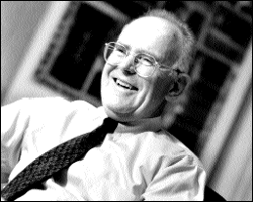
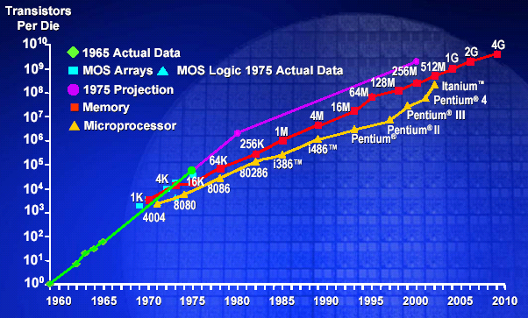
Moore’s Law: Gordon Moore,
Number of transistors per cost-effective integrated circuit doubles every N months (12 ≤ N ≤ 24)
“Cramming More Components onto Integrated Circuits”, Electronics, 1965
Notes:
Gordon Moore’s famous prediction from 1975. Held true for many years, but the end seems near. Let’s look at performance rather than just transistor count….

Slide 4
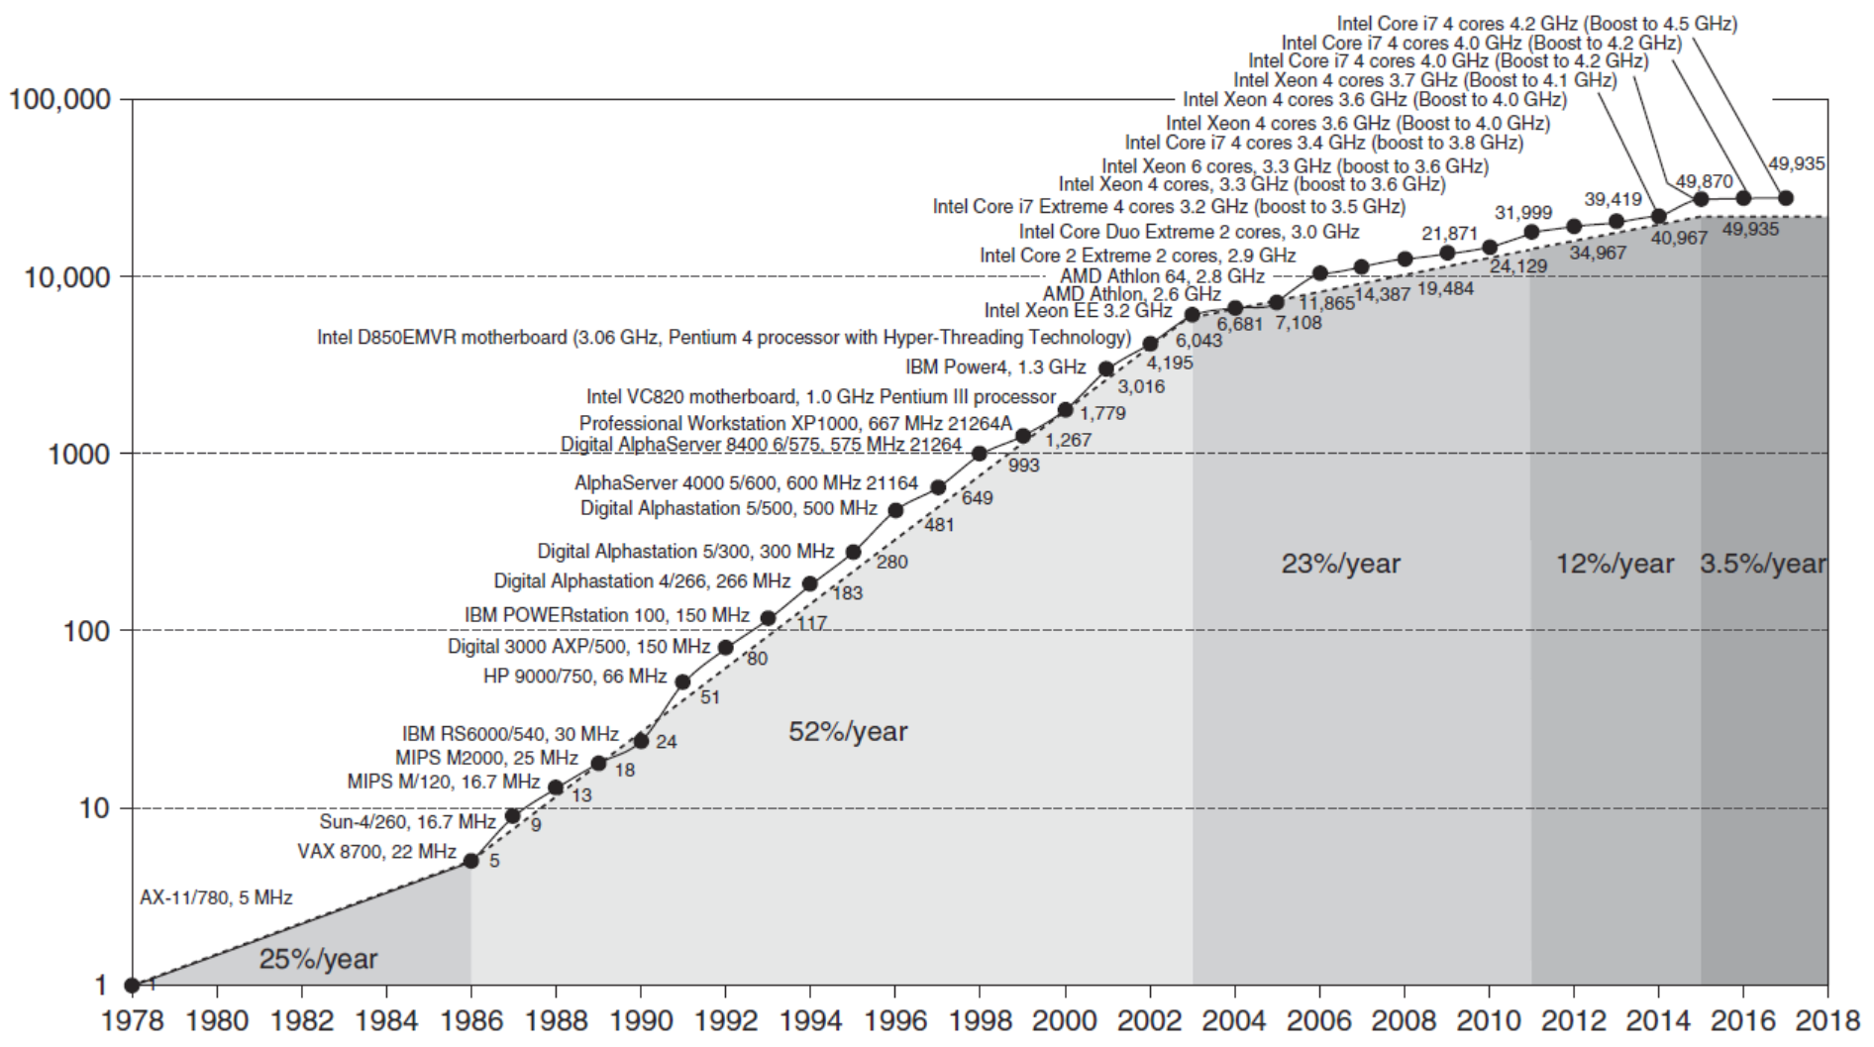
Processor Performance
Move to multi-processor
Introduction
RISC
Interpretations?
Notes:
Till mid 80-s, processor performance more technology driven (e.g., transistors, EE stuff)
From 86-2002, most advances came from architectural designs (RISC) and ILP (RISC enabled) – still some from technological and also a big increase from advances in floating point.
~2003, hit a wall due to not much more out of ILP, memory lag times, power, etc.

Slide 5
Shift to multi-proc/core Déjà vu all over again?
Multiprocessors imminent in 1970s, ‘80s, ‘90s, …
“… today’s processors … are nearing an impasse as technologies approach the speed of light..”
David Mitchell, The Transputer: The Time Is Now (1989)
Transputer was premature ⇒ Custom multiprocessors strove to lead uniprocessors ⇒ Procrastination rewarded: 2X seq. perf. / 1.5 years
“We are dedicating all of our future product development to multicore designs. … This is a sea change in computing”
Paul Otellini, President, Intel (2004)
Difference is all microprocessor companies switch to multiprocessors (AMD, Intel, IBM, Sun; all new Apples 2 CPUs) ⇒ Procrastination penalized: 2X sequential perf. / 5 yrs ⇒ Biggest programming challenge: 1 to 2 CPUs
Notes:
Skip…
The transputer (transistor computer) (early 80s) was the first general purpose microprocessor designed specifically to be used in parallel computing systems. The goal was to produce a family of chips ranging in power and cost that could be wired together to form a complete computer. The name was selected to indicate the role the individual transputers would play: numbers of them would be used as basic building blocks, just as transistors had earlier.

Slide 6
Current Trends in Architecture
Introduction
Instruction-Level Parallelism (ILP) gains have ended
Single processor performance improvement ended in 2003
No more Instruction-Level parallelism (ILP) to leverage
Power constraints
Memory constraints
New models for performance:
Data-level parallelism (DLP)
Thread-level parallelism (ThLP)
Request-level parallelism (RLP)
These require explicit restructuring of the application
Notes:
Other examples of a brick wall?
How about data modems using dial-up? 56.6kbps
Cell phones shrinking, then growing. Why?
MP3 players
CRT sizes?
Topology control research. Assumed Lasercomm between aircraft, but scintillation kills you.
What is the constraint for parallel computing?

Slide 7
Classes of Computers
Personal Mobile Device (PMD)
e.g. smart phones, tablet computers
Emphasis on energy efficiency and real-time
Desktop Computing
Emphasis on price-performance
Servers
Emphasis on availability, scalability, throughput
Clusters / Warehouse Scale Computers
Used for “Software as a Service (SaaS)”
Emphasis on availability and price-performance
Sub-class: Supercomputers, emphasis: floating-point performance and fast internal networks
Embedded Computers
Emphasis: price
Classes of Computers
Notes:
The nature of computing challenges has evolved… because the world of computing has evolved.

Slide 8
Parallelism
Classes of parallelism in applications:
Data-Level Parallelism (DLP)
Task-Level Parallelism (T_{a}LP)
Classes of architectural parallelism:
Instruction-Level Parallelism (ILP)
Vector architectures/Graphic Processor Units (GPUs)
Thread-Level Parallelism (T_{h}LP)
Request-Level Parallelism (RLP)
Classes of Computers
Notes:
Discuss this as a class

Slide 9
Flynn’s Taxonomy - 1966
Hardware classification based on available parallelism in:
instruction streams and data streams
Single instruction stream, single data stream (SISD)
Single instruction stream, multiple data streams (SIMD)
Vector architectures
Multimedia extensions
Graphics processor units
Multiple instruction streams, single data stream (MISD)
No commercial implementation
Multiple instruction streams, multiple data streams (MIMD)
Tightly-coupled MIMD (T_{h}LP)
Loosely-coupled MIMD (RLP, clusters)
Classes of Computers

Slide 10
Defining Computer Architecture
“Old” view of computer architecture:
Instruction Set Architecture (ISA) design
i.e. decisions regarding:
registers, memory addressing, addressing modes, instruction operands, available operations, control flow instructions, instruction encoding
“Real” computer architecture:
Specific requirements of the target machine
Design to maximize performance within constraints: cost, power, and availability
Includes ISA, microarchitecture, hardware
Defining Computer Architecture
Notes:
We will quantify using the “old” view of computer architecture, ‘cause it exists, ‘cause we can, ‘cause it’ll help us to understand/extend
But the research is now elsewhere

Slide 11
Instruction Set Architecture
Class of ISA
General-purpose registers
Register-memory vs load-store
RISC-V registers
32 g.p., 32 f.p.
Defining Computer Architecture
Register | Name | Use | Saver
x9 | s1 | saved | callee
x10-x17 | a0-a7 | arguments | caller
x18-x27 | s2-s11 | saved | callee
x28-x31 | t3-t6 | temporaries | caller
f0-f7 | ft0-ft7 | FP temps | caller
f8-f9 | fs0-fs1 | FP saved | callee
f10-f17 | fa0-fa7 | FP arguments | callee
f18-f27 | fs2-fs21 | FP saved | callee
f28-f31 | ft8-ft11 | FP temps | caller
Register | Name | Use | Saver
x0 | zero | constant 0 | n/a
x1 | ra | return addr | caller
x2 | sp | stack ptr | callee
x3 | gp | gbl ptr
x4 | tp | thread ptr
x5-x7 | t0-t2 | temporaries | caller
x8 | s0/fp | saved/ frame ptr | callee

Slide 12
Instruction Set Architecture
Memory addressing
RISC-V: byte addressed, aligned accesses faster
Addressing modes
RISC-V: Register, immediate, displacement (base+offset)
Other examples: autoincrement, indexed, PC-relative
Types and size of operands
RISC-V: 8-bit, 32-bit, 64-bit
Defining Computer Architecture
Defining Computer Architecture

Slide 13
Instruction Set Architecture
Operations
RISC-V: data transfer, arithmetic, logical, control, floating point
See Fig. 1.5 in text
Control flow instructions
Use content of registers (RISC-V) vs. status bits (x86, ARMv7, ARMv8)
Return address in register (RISC-V, ARMv7, ARMv8) vs. on stack (x86)
Encoding
Fixed (RISC-V, ARMv7/v8 except compact instruction set) vs. variable length (x86)
Defining Computer Architecture
Defining Computer Architecture

Slide 14
Trends in Technology
Integrated circuit technology (Moore’s Law)
Transistor density: 35%/year
Die size: 10-20%/year
Integration overall: 40-55%/year
DRAM capacity: 25-40%/year (slowing)
8 Gb (2014), 16 Gb (2019), possibly no 32 Gb
Flash capacity: 50-60%/year
8-10X cheaper/bit than DRAM
Magnetic disk capacity: recently slowed to 5%/year
Density increases may no longer be possible, maybe increase from 7 to 9 platters
8-10X cheaper/bit than Flash
200-300X cheaper/bit than DRAM
Trends in Technology

Slide 15
Bandwidth and Latency
Bandwidth or throughput
Total work done in a given time
32,000-40,000X improvement for processors
300-1200X improvement for memory and disks
Latency or response time
Time between start and completion of an event
50-90X improvement for processors
6-8X improvement for memory and disks
Trends in Technology

Slide 16
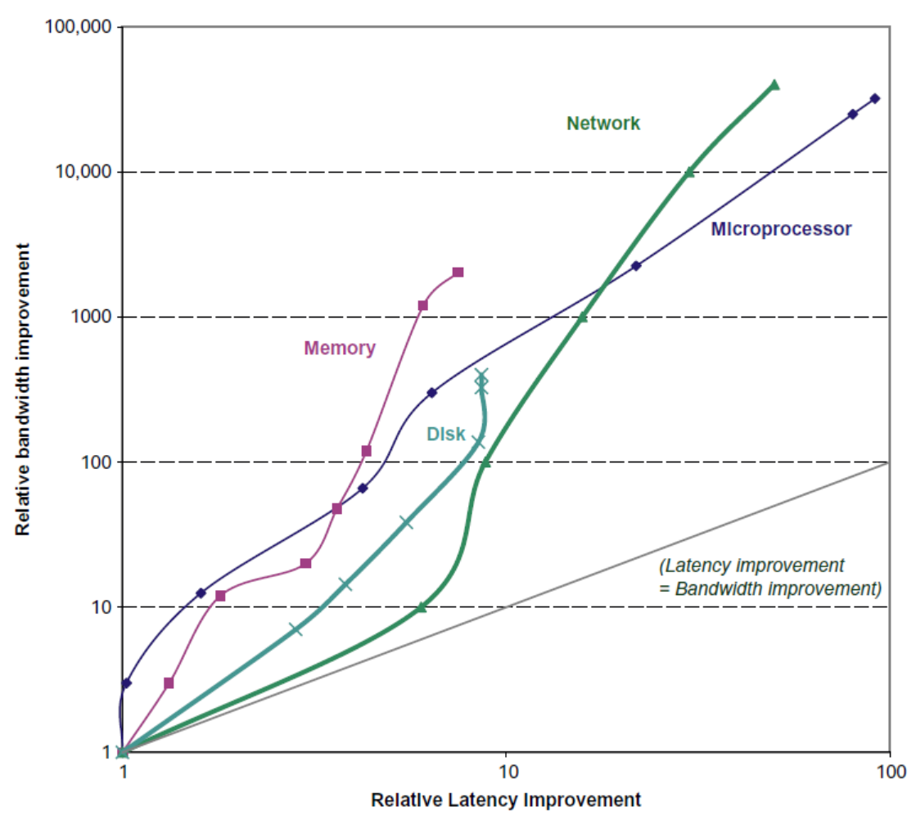
Bandwidth and Latency
Trends in Technology
Log-log plot of bandwidth and latency milestones

Slide 17
Transistors and Wires
Feature size
Minimum size of transistor or wire in x or y dimension
10 microns in 1971 to .011 microns in 2017
Transistor performance scales linearly
Wire delay does not improve with feature size!
Integration density scales quadratically
Trends in Technology

Slide 18
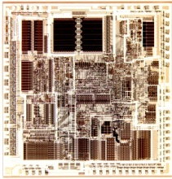
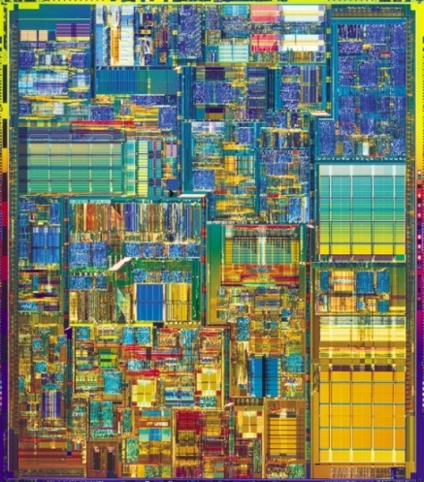
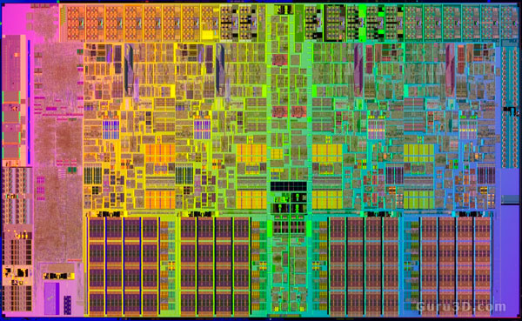
Transistors and Wires
2011 Sandy Bridge, “tock”, 32 nm, demo ’09
2012 Ivy Bridge “tick”, 22nm, demo ‘11
2013 Haswell “tock”, 22nm
2014 Broadwell “tick”, 14nm
2015 Skylake “tock”, 14nm
2016 Kaby Lake, 14nm, “optimization”
2018 CannonLake, 10nm, “process”
2019 IceLake, 10nm, “architecture”
TigerLake, 10nm, “optimization”
7nm, “process”
Notes:
Again, just some interesting facts.
Mention figure 1.10 pg 20. Went from 134K transistors in the 80286 to 1.70 billon transistors in i7

Slide 19
Power and Energy
Problem: Get power in, get power out
Thermal Design Power (TDP)
Characterizes sustained power consumption
Used as target for power supply and cooling system
Lower than peak power (1.5X higher), higher than average power consumption
Clock rate can be reduced dynamically to limit power consumption
Energy per task is often a better measurement
Trends in Power and Energy

Slide 20
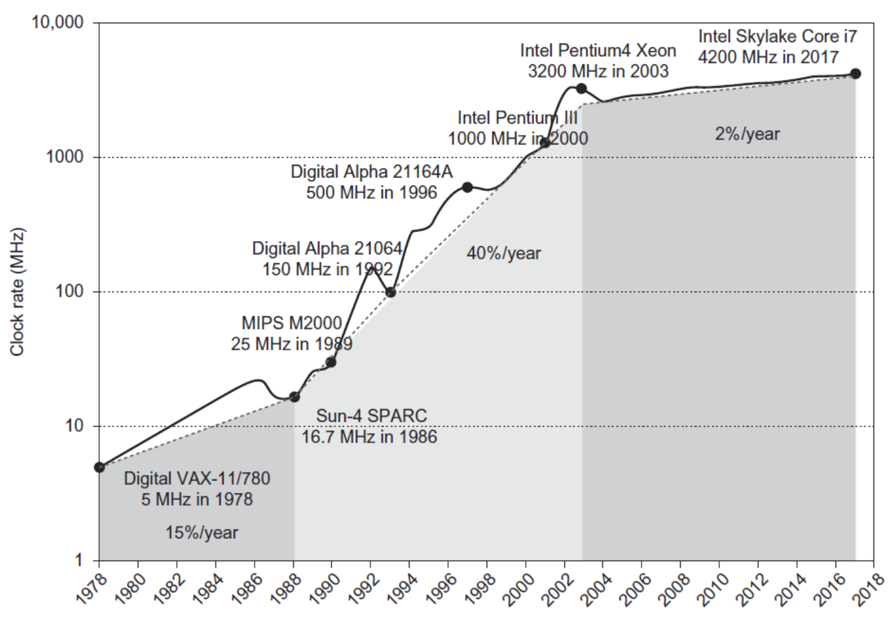
Power
Intel 80386 consumed ~ 2 W
3.3 GHz Intel Core i7 consumes 130 W
Heat must be dissipated from 1.5 x 1.5 cm chip
This is the limit of what can be cooled by air
Trends in Power and Energy

Slide 21
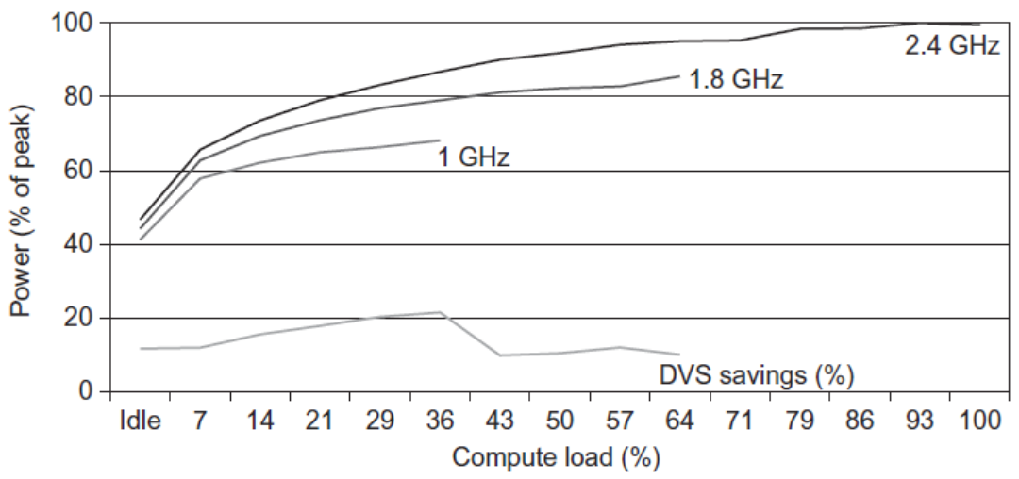
Reducing Power
Techniques for reducing power:
Do nothing well
Dynamic Voltage-Frequency Scaling
Low power state for DRAM, disks
Overclocking, turning off cores
Trends in Power and Energy

Slide 22
Dynamic Energy and Power
Dynamic energy
Transistor switch from 0 -> 1 or 1 -> 0
½ x Capacitive load x Voltage²
Dynamic power
½ x Capacitive load x Voltage² x Frequency switched
Reducing clock rate reduces power, not energy
Trends in Power and Energy

Slide 23
Define and quantify power ( 1 / 2)
For CMOS chips, traditional dominant energy consumption has been in switching transistors, called dynamic power
For mobile devices, energy is a better metric
For a fixed task, slowing clock rate (frequency switched) reduces power, but not energy
Capacitive load is a function of
number of transistors connected to output, and
technology, which determines capacitance of wires and transistors
Dropping voltage helps both, so went from 5V to 1V
To save energy & dynamic power, most CPUs now turn off clock of inactive modules (e.g. Fl. Pt. Unit)
Notes:
Energy is the ability to do work, measured in Joules (battery amount, etc)
Power is the rate at which the work is done, measured in Watts (e.g., light bulbs)
Thought: dropping from 5V to 1V helps power, but what tech required to allow that to work?

Slide 24
Example of quantifying power
Suppose 15% reduction in voltage results in a 15% reduction in frequency. What is impact on dynamic power?

Slide 25
Define and quantify power (2 / 2)
Because leakage current flows even when a transistor is off, now static power important too
Leakage current increases in processors with smaller transistor sizes
Increasing the number of transistors increases power even if they are turned off
In 2006, goal for leakage is <25% of total power consumption; high performance designs at <40%
Very low power systems even gate voltage to inactive modules to control loss due to leakage

Slide 26
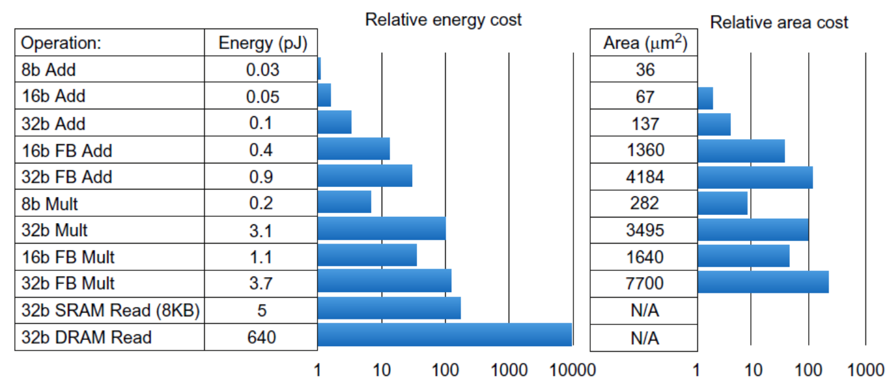
Static Power
Static power consumption
25-50% of total power
Current_{static} x Voltage
Scales with number of transistors
To reduce: power gating
Trends in Power and Energy

Slide 27
Trends in Cost
Trends in Cost
Cost driven down by learning curve
Yield
DRAM: price closely tracks cost
Microprocessors: price depends on volume
10% less for each doubling of volume

Slide 28


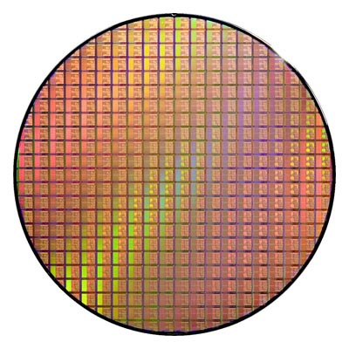

Integrated Circuit Cost
Trends in Cost
Bose-Einstein formula:
Defects per unit area = 0.016-0.057 defects per square cm (2010)
N = process-complexity factor = 11.5-15.5 (40 nm, 2010)

Slide 29
Dependability
Dependability
Module reliability
Mean time to failure (MTTF)
Mean time to repair (MTTR)
Mean time between failures (MTBF) = MTTF + MTTR
Availability = MTTF / MTBF

Slide 30
Define and quantify dependability (1/2)
How to decide when a system is operating properly?
Infrastructure providers now offer Service Level Agreements (SLA) to guarantee that their networking or power service would be dependable
Systems alternate between 2 states of service with respect to an SLA:
Service accomplishment, where the service is delivered as specified in SLA
Service interruption, where the delivered service is different from the SLA
Failure = transition from state 1 to state 2
Restoration = transition from state 2 to state 1

Slide 31
Define and quantify dependability (2/2)
Module reliability = measure of continuous service accomplishment (or time to failure)
Mean Time To Failure (MTTF) measures Reliability
Failure Rate = 1/MTTF (Traditionally reported as failures per billion hours of operation or Failures In Time (FIT)
Mean Time To Repair (MTTR) measures Service Interruption
Mean Time Between Failures (MTBF) = MTTF + MTTR
Module availability measures service as alternate between the 2 states of accomplishment and interruption (number between 0 and 1, e.g. 0.9)
Module availability = MTTF / ( MTTF + MTTR)

Slide 32
Example calculating reliability
If modules have exponentially distributed lifetimes (age of module does not affect probability of failure), overall failure rate is the sum of failure rates of the modules
Calculate FIT and MTTF for 10 disks (1M hour MTTF per disk), 1 disk controller (0.5M hour MTTF), and 1 power supply (0.2M hour MTTF):

Slide 33
Example calculating reliability
If modules have exponentially distributed lifetimes (age of module does not affect probability of failure), overall failure rate is the sum of failure rates of the modules
Calculate FIT and MTTF for 10 disks (1M hour MTTF per disk), 1 disk controller (0.5M hour MTTF), and 1 power supply (0.2M hour MTTF):

Slide 34
Measuring Performance
Typical performance metrics:
Response time
Throughput
Speedup of X relative to Y
Execution time_{Y} / Execution time_{X}
Execution time
Wall clock time: includes all system overheads
CPU time: only computation time
Benchmarks
Kernels (e.g. matrix multiply)
Toy programs (e.g. sorting)
Synthetic benchmarks (e.g. Dhrystone)
Benchmark suites (e.g. SPEC06fp, TPC-C)
Measuring Performance

Slide 35
Performance & Speedup
Performance is in units of things per sec
bigger is better
If we are primarily concerned with response time
performance(x) = 1 execution_time(x)
" X is n times faster than Y" means
Performance(X) Execution_time(Y)
n = =
Performance(Y) Execution_time(X)

Slide 36
Performance: What to measure
Usually rely on benchmarks vs. real workloads
To increase predictability, collections of benchmark applications-- benchmark suites -- are popular
SPECCPU: popular desktop benchmark suite
CPU only, split between integer and floating point programs
SPECint2000: has 12 integer & 14 flt-point pgms
SPECCPU2006: has 12 integer & 17 flt-point pgms
SPECSFS (NFS file server) and SPECWeb (WebServer) added as server benchmarks
Transaction Processing Council measures server performance and cost-performance for databases
TPC-C Complex query for Online Transaction Processing
TPC-H models ad hoc decision support
TPC-W a transactional web benchmark
TPC-App application server and web services benchmark

Slide 37
How to Summarize Suite Performance (1/6)
Arithmetic average of execution time of all pgms?
But they vary by 4X in speed, so some would be more important than others in arithmetic average
Could add a weights per program, but how pick weight?
Different companies want different weights for their products
SPECRatio: Normalize execution times to reference computer, yielding a ratio proportional to performance =
time on reference computer
time on computer being rated

Slide 38
How to Summarize Suite Performance (2/6)
If program SPECRatio on Computer A is 1.25 times bigger than Computer B, then
Note that when comparing 2 computers as a ratio, execution times on the reference computer drop out, so choice of reference computer is irrelevant

Slide 39
How to Summarize Suite Performance (3/6)
Since ratios, proper mean is geometric mean (SPECRatio unitless, so arithmetic mean meaningless)
Why geometric mean of ratios is used to summarize performance:
Geometric mean of the ratios is the same as the ratio of the geometric means
Ratio of geometric means = Geometric mean of performance ratios ⇒ choice of reference computer is irrelevant!

Slide 40
How to Summarize Suite Performance (4/6)
Does a single mean well summarize performance of programs in benchmark suite?
Can decide if mean a good predictor by characterizing variability of distribution using standard deviation
Like geometric mean, geometric standard deviation is multiplicative rather than arithmetic

Slide 41
How to Summarize Suite Performance (5/6)
Can simply take the logarithm of SPECRatios, compute the standard mean and standard deviation, and then take the exponent to convert back:

Slide 42
How to Summarize Suite Performance (6/6)
Standard deviation is more informative if we know that the distribution has a standard form
bell-shaped normal distribution, with data symmetric around mean
lognormal distribution, where logarithms of data--not data itself--are normally distributed (symmetric) on a logarithmic scale
For a lognormal distribution, we expect that
68% of samples fall in range
95% of samples fall in range
Note: Excel provides functions EXP(), LN(), and STDEV() that make calculating geometric mean and multiplicative standard deviation easy

Slide 43
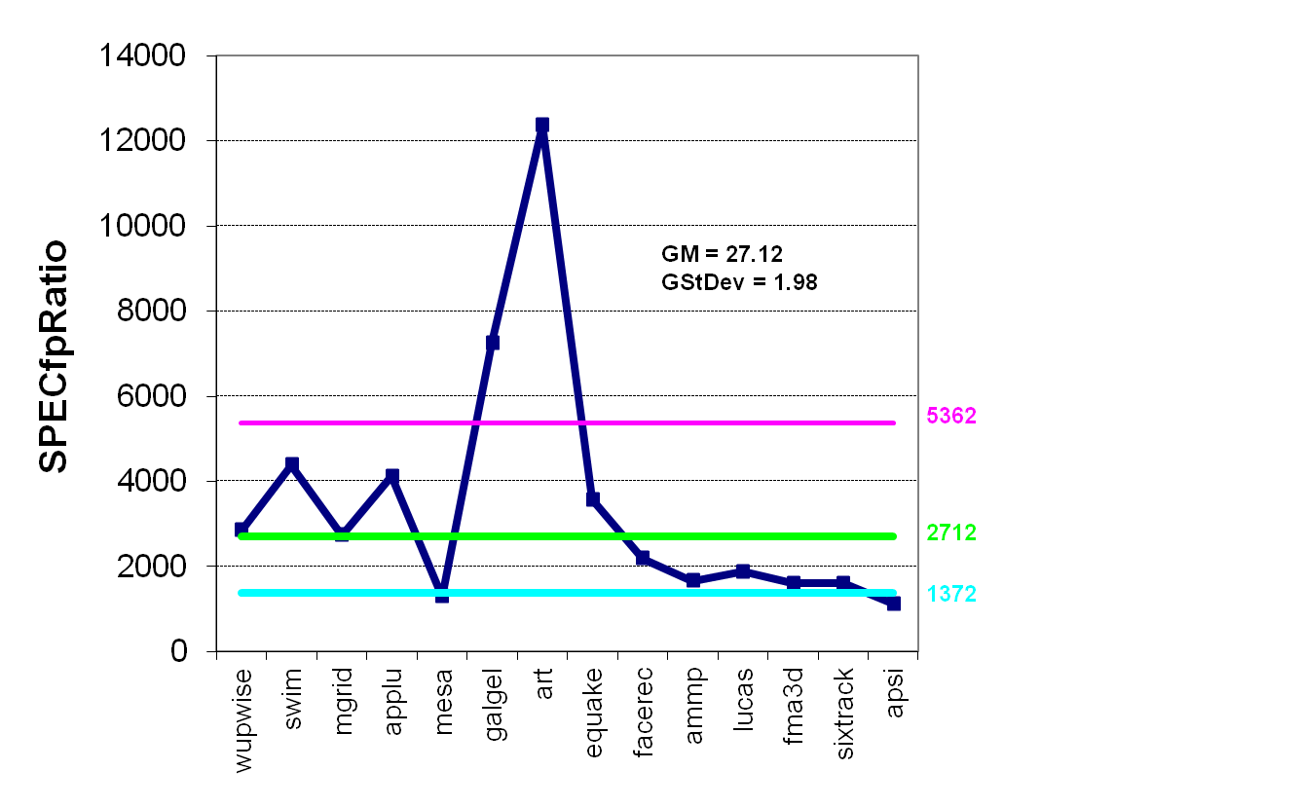
Example Standard Deviation (1/2)
GM and multiplicative StDev of SPECfp2000 for Itanium 2
Outside 1 StDev
Notes:
Note Y-axis is *100 since actual SPECcpu numbers when ran are multiplied by 100 to remove the decimal point

Slide 44
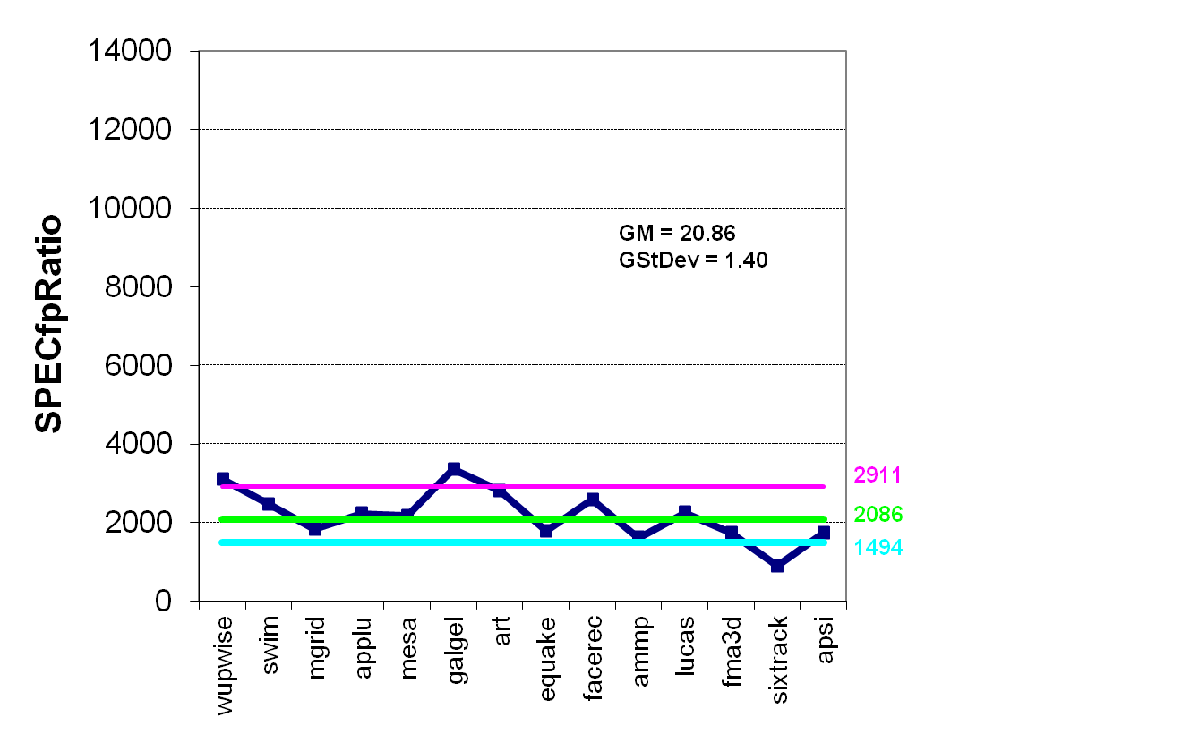
Example Standard Deviation (2/2)
GM and multiplicative StDev of SPECfp2000 for AMD Athlon
Outside 1 StDev
Notes:
Note Y-axis is *100 since actual SPECcpu numbers when ran are multiplied by 100 to remove the decimal point

Slide 45
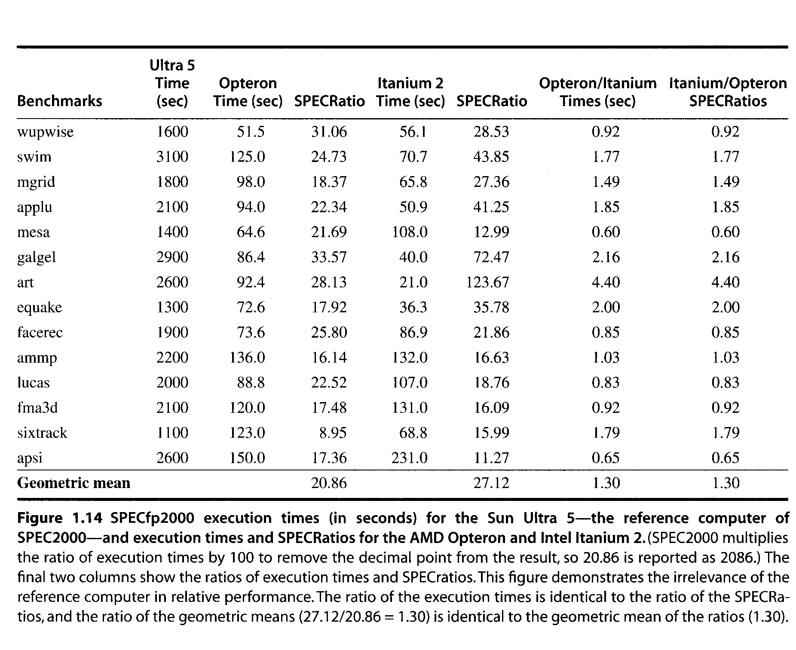
Ratio of means – Means of ratios – Huh??

Slide 46
Principles of Computer Design
Principles
Take Advantage of Parallelism
e.g. multiple processors, disks, memory banks, pipelining, multiple functional units
Principle of Locality
Reuse of data and instructions
Focus on the Common Case
Amdahl’s Law

Slide 47
Focus on the Common Case
Common sense guides computer design
Since its engineering, common sense is valuable
In a design trade-off, favor frequent over infrequent case
E.g., Instruction fetch and decode unit used more frequently than multiplier, so optimize it 1st
E.g., If database server has 50 disks / processor, storage dependability dominates system dependability, so optimize it 1st
Frequent case is often simpler and can be done faster than the infrequent case
E.g., overflow is rare when adding 2 numbers, so improve performance by optimizing more common case of no overflow
May slow down overflow, but overall performance improved by optimizing for the normal case
What is frequent case and how much performance improved by making case faster => Amdahl’s Law

Slide 48
4) Amdahl’s Law
Best you could ever hope to do:

Slide 49
Amdahl’s Law example
A hardware improvement can speed up 13% of the instructions executed during some benchmark. What is the maximum possible speedup?

Slide 50
Amdahl’s Law example
New CPU 10X faster
I/O bound server, so 60% time waiting for I/O
Human nature to be intrigued by 10X faster…
In reality, its just 1.6X faster

Slide 51
Principles of Computer Design
Principles
The Processor Performance Equation

Slide 52


Principles of Computer Design
Principles
Different instruction types having different CPIs

Slide 53
Cycles Per Instruction
“Average Cycles per Instruction”
“Instruction Frequency”
Invest Resources where time is spent!

Slide 54
Example: Calculating CPI
Base Machine (Reg / Reg)
Op Freq CPI_{i} F· CPI_{i} (% Time)
ALU 50% 1 .5 (33%)
Load 20% 2 .4 (27%)
Store 10% 2 .2 (13%)
Branch 20% 2 .4 (27%)
1.5
Typical Mix

Slide 55
Fallacies and Pitfalls
All exponential laws must come to an end
Dennard scaling (constant power density)
Stopped by threshold voltage
Disk capacity
30-100% per year to 5% per year
Moore’s Law
Most visible with DRAM capacity
ITRS disbanded
Only four foundries left producing state-of-the-art logic chips
11 nm, 3 nm might be the limit

Slide 56
Fallacies and Pitfalls
Microprocessors are a silver bullet
Performance is now a programmer’s burden
Falling prey to Amdahl’s Law
A single point of failure
Hardware enhancements that increase performance also improve energy efficiency, or are at worst energy neutral
Benchmarks remain valid indefinitely
Compiler optimizations target benchmarks

Slide 57
Fallacies and Pitfalls
The rated mean time to failure of disks is 1,200,000 hours or almost 140 years, so disks practically never fail
MTTF value from manufacturers assume regular replacement
Peak performance tracks observed performance
Fault detection can lower availability
Not all operations are needed for correct execution

